Slide 1
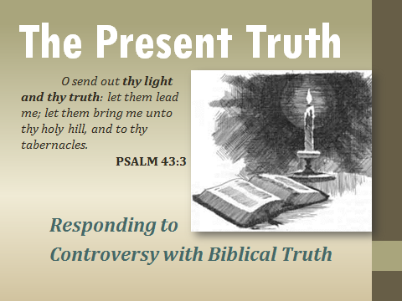
Conclusion

Slide 2
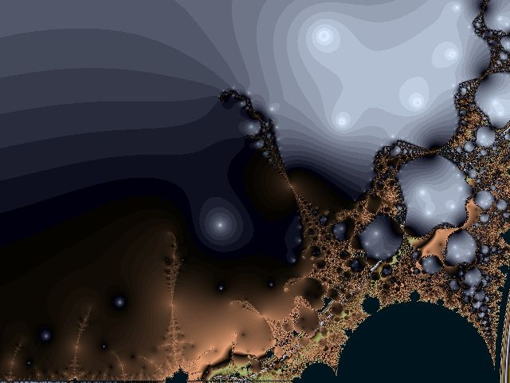
The Present
Truth
Conclusion
Thy fathers went down into Egypt with threescore and ten persons; and now the LORD thy God hath made thee as the stars of heaven for multitude.
DEUTERONOMY 10:22

Slide 3
(“Vertical Relationship”)
II PETER 1:10-12
10 Wherefore the rather, brethren, give diligence to make your calling and election sure: for if ye do these things, ye shall never fall: 11 For so an entrance shall be ministered unto you abundantly into the everlasting kingdom of our Lord and Saviour Jesus Christ. 12 Wherefore I will not be negligent to put you always in remembrance of these things, though ye know them, and be established in the present truth.

Slide 4
(“Horizontal Relationship”)
PHILIPPIANS 1:6-7
6 Being confident of this very thing, that he which hath begun a good work in you will perform it until the day of Jesus Christ: 7 Even as it is meet for me to think this of you all, because I have you in my heart; inasmuch as both in my bonds, and in the defence and confirmation of the gospel, ye all are partakers of my grace.

Slide 5
I TIMOTHY 6:20-21
20 O Timothy, keep that which is committed to thy trust, avoiding profane and vain babblings, and oppositions of science falsely so called: 21 Which some professing have erred concerning the faith. Grace be with thee. Amen.
Antithesis:
The placing of a sentence or one of its parts against another to which it is opposed to form a balanced contrast of ideas.

Slide 6
JEZEBEL.RELIGION
100 When God sends forth a message and tells the people, and they don't receive it, then He withdraws His servant and sends His plagues: famine, death, spiritually speaking, physically also. You watch for a depression, brother… You haven't seen nothing. You think you're dying for a good spiritual revival; you wait till after a bit. You just wait, long and cry to hear the Word of God. The Bible said so. "There'll be a famine in the last days, and not for bread and water alone, but for hearing the true Word of God." But that voice will be quiet in the wilderness somewhere, hid away. 61-0319

Slide 7
Defence: (Gr.) apologia
Verbal defence, speech in defence, a reasoned statement or argument.
I PETER 3:14-15
14 But and if ye suffer for righteousness' sake, happy are ye: and be not afraid of their terror, neither be troubled; 15 But sanctify the Lord God in your hearts: and be ready always to give an answer to every man that asketh you a reason of the hope that is in you with meekness and fear:

Slide 8
IT.BECOMETH.US.TO.FULFIL.ALL.RIGHTEOUSNESS
61-1001
102 Noah knew… there was coming a flood… the rains would pour out of the skies, like rivers opening up, although it was firmly against scientific matters in that day. The scientists, no doubt, criticized Noah, and said, "We can scientifically prove to you that there's no water up there…” And they were great scientists… They could prove that there was no water there. But it was becoming to Noah, after he'd knowed the plan of God, hammered away on the ark, for he knowed that only that ark would be the only thing that would float. No matter, if it was scientifically proven there was no water there, if the Word of God had said it would rain, it's going to rain.

Slide 9
A.GREATER.THAN.SOLOMON.IS.HERE
98 Do you believe He would have anything to do with a hypocrite? Jesus? No, sir. Do you believe He'd associate Himself in lies? Not our God. No. But our God is responsible for His Word. And humbly, He's permitting this to be done, not because He has to, but to show the people that He is God and keeps His promise, God.
62-0725

Slide 10
MATTHEW 3:1-3
1 In those days came John the Baptist, preaching in the wilderness of Judaea, 2 And saying, Repent ye: for the kingdom of heaven is at hand. 3 For this is he that was spoken of by the prophet Esaias, saying, The voice of one crying in the wilderness, Prepare ye the way of the Lord, make his paths straight.

Slide 11
DEUTERONOMY 10:20-22
20 Thou shalt fear the LORD thy God; him shalt thou serve, and to him shalt thou cleave, and swear by his name. 21 He is thy praise, and he is thy God, that hath done for thee these great and terrible things, which thine eyes have seen. 22 Thy fathers went down into Egypt with threescore and ten persons; and now the LORD thy God hath made thee as the stars of heaven for multitude.

Slide 12
The “Fear of the Lord”
Heb. yare‘ to stand in awe of, reverence, honor, respect; to cause astonishment and awe, be held in awe.
JOSHUA 4:14
On that day the LORD magnified Joshua in the sight of all Israel; and they feared him, as they feared Moses, all the days of his life.

Slide 13
PSALM 46:1-3
1 God is our refuge and strength, a very present help in trouble. 2 Therefore will not we fear, though the earth be removed, and though the mountains be carried into the midst of the sea; 3 Though the waters thereof roar and be troubled, though the mountains shake with the swelling thereof.

Slide 14
PROVERBS 3:7, 25
7 Be not wise in thine own eyes: fear the LORD, and depart from evil.
25 Be not afraid of sudden fear, neither of the desolation of the wicked, when it cometh.
ECCLESIASTES 12:13
Let us hear the conclusion of the whole matter: Fear God, and keep his commandments: for this is the whole duty of man.

Slide 15
I THESSALONIANS 5:3-4
3 For when they shall say, Peace and safety; then sudden destruction cometh upon them, as travail upon a woman with child; and they shall not escape. 4 But ye, brethren, are not in darkness, that that day should overtake you as a thief.
MALACHI 4:5
Behold, I will send you Elijah the prophet before the coming of the great and dreadful day of the LORD:

Slide 16
GENESIS 15:4-5, 13-14
4 And, behold, the word of the LORD came unto him, saying, This shall not be thine heir; but he that shall come forth out of thine own bowels shall be thine heir. 5 And he brought him forth abroad, and said, Look now toward heaven, and tell the stars, if thou be able to number them: and he said unto him, So shall thy seed be.
13 And he said unto Abram, Know of a surety that thy seed shall be a stranger in a land that is not theirs, and shall serve them; and they shall afflict them (humiliate) four hundred years; 14 And also that nation, whom they shall serve, will I judge: and afterward shall they come out with great substance.

Slide 17
The Silver Tipped Grizzly
A.GREATER.THAN.SOLOMON.IS.HERE 62-0725
84 I like to hunt. My conversion never took that out of me. I'd like to tell you a little story about hunting, where He told me what I was going to do, where I'd go, a caribou I'd get, where he'd be laying, a man would have a green checkered shirt on; and would kill a grizzly 'fore I got back. Went right there, and Eddy heard me tell it the day before we left down there. Two days later he stood right there and seen every bit of it come just to pass as I told. I said the horns would be exactly forty-two inches high.

Slide 18
And the guide said, "Forty-two exactly?“ He said, "Where's that grizzly bear up on top of this mountain? Bro. Branham, according to what you told me, that you're going to kill a grizzly bear before you get back..." And his wife had put it in his camp bag, and he told me he didn't even have one. I said, "Well, then, there's going to be somebody's going to have it, 'cause it's going to be there." And he had that green checkered shirt on.

Slide 19
The Vision of Joseph
GENESIS 37:5-8
5 And Joseph dreamed a dream, and he told it his brethren: and they hated him yet the more. 6 And he said unto them, Hear, I pray you, this dream which I have dreamed: 7 For, behold, we were binding sheaves in the field, and, lo, my sheaf arose, and also stood upright; and, behold, your sheaves stood round about, and made obeisance to my sheaf. 8 And his brethren said to him, Shalt thou indeed reign over us? or shalt thou indeed have dominion over us? And they hated him yet the more for his dreams, and for his words.

Slide 20
GENESIS 42:5-9
5 And the sons of Israel came to buy corn among those that came: for the famine was in the land of Canaan. 6 And Joseph was the governor over the land, and he it was that sold to all the people of the land: and Joseph's brethren came, and bowed down themselves before him with their faces to the earth. 7 And Joseph saw his brethren, and he knew them, but made himself strange unto them, and spake roughly unto them; and he said unto them, Whence come ye? And they said, From the land of Canaan to buy food. 8 And Joseph knew his brethren, but they knew not him. 9 And Joseph remembered the dreams which he dreamed of them…

Slide 21
GENESIS 43:26-28
26 And when Joseph came home, they brought him the present which was in their hand into the house, and bowed themselves to him to the earth. 27 And he asked them of their welfare, and said, Is your father well, the old man of whom ye spake? Is he yet alive? 28 And they answered, Thy servant our father is in good health, he is yet alive. And they bowed down their heads, and made obeisance.

Slide 22
THE.UNVEILING.OF.GOD
307 The old badger skin, denominations, is tore down. I've broke through that, into the Shekinah Glory, and I see the Word. I see the Pillar of Fire moving. I see the Word made manifest. What He said He would do in these last days, I see it growing. I see the children eating that Shekinah Bread coming from the ripening of that Word, which believes It. What a wonderful hour we're living in!
64-0614

Slide 23
THE RAPTURE
201 And then when them women passed by, all kinds of rock {and roll} short hair, and painted faces. And as they passed by like that, supposed to be virgins to Christ... And when she passed by like that, I turned my head… And then I heard something like a "Onward Christian Soldiers." And I looked, and here come that sainted bunch of little girls, all correctly dressed, their hair hanging way down, clean, marching like this to the step of the Gospel. She was the Word. And it looked like one out of every nation. I was looking at it as they passed by...

Slide 24
Instead of going down, they started going up. I noticed two or three of them getting out of line; I screamed, "Stay in line." And the vision left me, and I was standing in this room screaming, "Stay in line.”
204 Wonder, could it be already passed? Could the Bride already be called? Is that what we're going through today? She's has to be molded and made into the image of Christ, and Christ is the Word.
65-1204

Slide 25
PROVING.HIS.WORD
108 He comes to deliver the children of Israel, what does He do? His same way, He sends His prophet. His prophet's got the Word. The signs and wonders of the Word promised backs it up, that it's exactly the Truth.
110 And in the wilderness journey, it came to pass that they disbelieved this prophet, after seeing the Word being so confirmed, the Bride got out of step (you know what I'm speaking about, in the vision, see, "got out of step"). There was one standing up, by the name of Joshua, and Caleb, and believed the Word of promised true, regardless of what the circumstances was.
64-0816

Slide 26
EVENTS.MADE.CLEAR.BY.PROPHECY
95 The church did not believe him, because he was not known of them… two Scriptures a-vindicated him: Mal. 3 & Is. 40:3. See, both those Scriptures spoke of a man coming, preparing the way of the Lord. He met every specification of it... And there he was, in every rugged way… Always watch their message, watch what they did. Now, we find out if they would've looked back and seen what the Bible said, and watched the nature of the man, and how perfect he was in time with the Scriptures they ought to have knowed that was him… They did not believe the identification of prophecy in their hour.
65-0801

Slide 27
99 Notice, they laughed at him, calling him some "screaming, wild unlearned fanatic with no schooling." As usual they judge him by his education. They judge him by his grammar, by the way he dressed. He had a piece of sheepskin around him, and a camel skin belt on; he was all hairy. Walking out in the waters, no church, no pew, no cooperation, they couldn't accept that…Then John's prophecy was vindicated in God's own order. The Bible said the Word of the Lord comes to the prophet. And Jesus was the Word. And John was prophesying of the coming of the Word for fulfillment, and Jesus the Word came to the prophet in the water.

Slide 28
THE.SUPERNATURAL 56-0129
E-37 …I stood in Cairo, Egypt, where Egypt once knowed and ruled the world and chair of the Pharaohs, and there's nothing left but the Sphinx, and a few of the pyramids is standing as relics of a once great worldwide empire.
Brother and sister, our great America and our great economy that we have is rottening under the foundations, and someday, I see it in the making right now, she'll lay in the ruins. And you young men today, you young women… the folly of the young heart, but one day will mold yonder in a graveyard somewhere. Why? Because all mortal has to give a way to immortality. Every nation has to fall, because there's coming a nation that'll not be ruled by men, but by Christ.

Slide 29
JEZEBEL.RELIGION 61-0319
83 The preachers got right along, just knucked down with them, went right on with them, all the system. The whole Israelite system went right along with Jezebel. They had a form, yes. And don't the Bible tell us that in this last days they'll have a form of godliness? All the prophecies are fulfilled, brother; we're at the end. Nationally, we're at the end. Spiritually, we are at the end. Every system is at its end. The next thing is the coming of the Lord and the translation of the Church.

