Slide 1
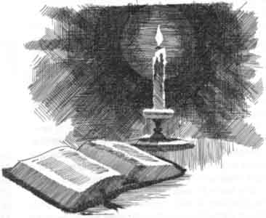
The Present Truth 5
Wherefore I will not be negligent to put you always in remembrance of these things, though ye know them, and be established in the present truth.
II PETER 1:12
Responding to
Controversy with Biblical Truth

Slide 2

TRYING.TO.DO.GOD.A.SERVICE
114 And it must be according to His Word that has been spoken. It must. I don't care how well you say this ought to be, or that ought to be, or this ought to be. It's got to be according to His Word; according to His time and His season.
65-0718

Slide 3
THE.EASTER.SEAL
159 Watch the action of those disciples, a scared. They knowed Jesus was the Truth, but, you see, It was against the popular idea, the popular religion of the hour, the most strictest religion, Pharisees, Sadducees, and so forth, their cults, clans, and denominations. They were against That, "Heresy." But Jesus was the identified Word. 65-0410
WHY.IT.HAD.TO.BE.SHEPHERDS
18 …The great thing, all the Word of God fits right together. If it doesn't fit together, it's not God's Word that's misfit; it's your thought is misfitting to the Word. It all fits together. 64-1221

Slide 4
RESURRECTION.OF.JAIRUS.DAUGHTER
6 And what I read here is His Word. It will never change; It'll never pass away. It's eternally right. Mine may fail, 'cause I'm just a man, speak like any other man, make mistakes and everything. But when He speaks, mark His Words; it's the truth.
54-0302

Slide 5
LUKE 11:49-52
49 Therefore also said the wisdom of God, I will send them prophets and apostles, and some of them they shall slay and persecute: 50 That the blood of all the prophets, which was shed from the foundation of the world, may be required of this generation; 51 From the blood of Abel unto the blood of Zacharias, which perished between the altar and the temple: verily I say unto you, It shall be required of this generation. 52 Woe unto you, lawyers! for ye have taken away the key of knowledge: ye entered not in yourselves, and them that were entering in ye hindered.

Slide 6
John Wesley
52. key of knowledge-not the key to open knowledge, but knowledge, the only key to open heaven. In Matt. 23:13 , they are accused of shutting heaven; here of taking away the key, which was worse. A right knowledge of God's Word is eternal life (Jn. 17:3); but this they took away from the people, substituting for it their wretched traditions.
JOHN 17:3
And this is life eternal, that they might know thee the only true God, and Jesus Christ, whom thou hast sent.

Slide 7
PHILIPPIANS 3:7-9
7 But what things were gain to me, those I counted loss for Christ. 8 Yea doubtless, and I count all things but loss for the excellency of the knowledge of Christ Jesus my Lord: for whom I have suffered the loss of all things, and do count them but dung, that I may win Christ, 9 And be found in him, not having mine own righteousness, which is of the law, but that which is through the faith of Christ, the righteousness which is of God by faith:

Slide 8
Key of Knowledge: (Gr.) gnosis
The general knowledge of Christian principles, the deeper more perfect and enlarged knowledge of this religion, such as belongs to the more advanced, especially of things lawful and unlawful for Christians; moral wisdom, such as is seen in right living.
Example: I Peter 3:7
Likewise, ye husbands, dwell with them according to knowledge, giving honour unto the wife, as unto the weaker vessel, and as being heirs together of the grace of life; that your prayers be not hindered.

Slide 9
WHY
5 Brother Williams, God ever be with you and your son in this great work. Brother, here, the missionaries and so forth... How I appreciate this. Never, never get away from it, friends. Don't never let that spirit of worship and that clean holiness ever die among you. Keep that light burning, for it's the lifeline of the church. It's Christ in His Church.
60-0401

Slide 10
Holiness (def.)
To divide off, to mark off from other things and other people, making something different, distinct, not common.
WHY? 63-0626
126 The same God, lived one time, still lives today. His same doctrine of holiness just lives tonight the same as it ever lived, just the same thing. Notice, the people has got away from the doctrine of it, that's all.

Slide 11
Heresy:
1. Dissensions arising from diversity of opinions and aims.
2. Any belief or theory that is strongly at variance with established beliefs or customs. In certain historical Christian, Jewish and some modern cultures, espousing such ideas can be and were punishable by law.
3. Although less common than in the medieval period, formal charges of heresy within Christian churches still occur. Key issues in the Protestant churches have included modern biblical criticism, the nature of God, and the acceptability of gay clergy.

Slide 12
Holiness
1. Not simply a Dress Code;
2. Humility and Purity are always connected to Holiness;
3. The Presence of God.

Slide 13
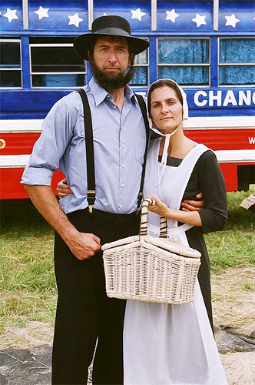
dress code (n)
A set of rules specifying the garb or type of clothing to be worn by a group or by people under specific circumstances:

Slide 14
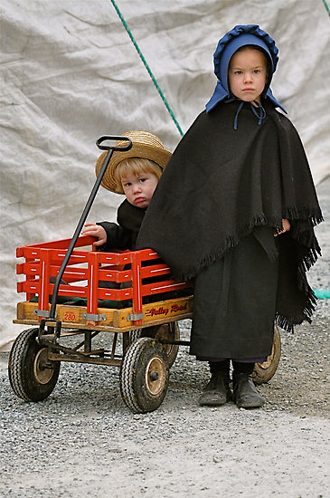
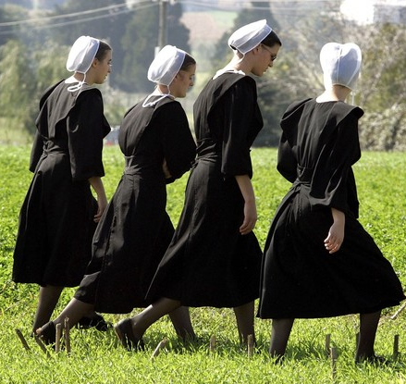

Slide 15
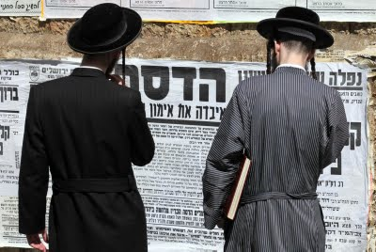
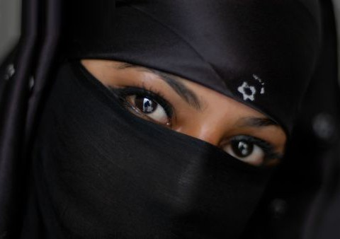

Slide 16
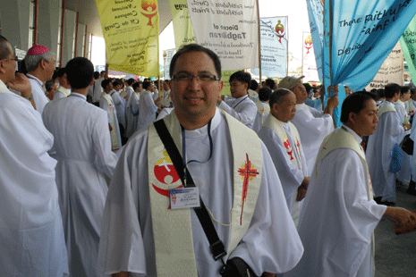
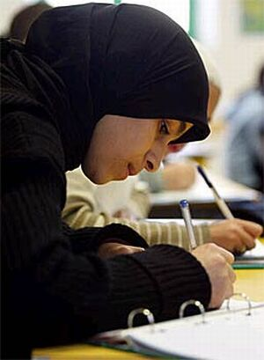

Slide 17
Holiness
1. Not simply a Dress Code;
2. Humility and Purity are always connected to Holiness;
3. The Presence of God.

Slide 18
I TIMOTHY 2:9-10
9 In like manner also, that women adorn themselves in modest apparel, with shamefacedness and sobriety; not with broided hair, or gold, or pearls, or costly array; 10 But (which becometh women professing godliness ) with good works.

Slide 19
64-0823 COD
244. Bro. Branham, what do you think about our sisters in the church wearing such short dresses? Doesn't it mar our testimony and set the wrong example for our young people in this our church? It seems so i-n... to see a grown woman wearing a dress so short that it shows her knees when she walks.
Ever who you are, sister or brother, whoever it is, I agree with you 100%. It's a disgrace, but tell me what to do about it. I preach it just as hard as I know how to preach it; they do it the same.

Slide 20
So it's their judgment, 'cause the Word's went forth. Yes, I'm certainly against them little old skin-tight dresses... I constantly fuss at my kids, Becky and Sarah. I don't care how little they are... Meda takes Becky apart every day about it. 'Cause kids, you can expect that in kids, and you have to correct them; but when it comes to a woman, there's something wrong there.

Slide 21
A.MISSIONARY.TALK
1 Now, in the Bible, we always try at our church to follow the rules and regulations of the Scripture, just as close as we can. Some people sprinkle the little children, infant baptism. I never did find that in the Scripture.
58-0330

Slide 22
64-0823 COD
69 There was a Dunkard girl, had just received the Holy Ghost… and she said, "Brother Branham, do you think it's wrong for a Christian girl to wear a 'scandal skirt'? It shows the underskirt.“
I said, "What is in a woman that would make her want to show her underneath clothes to some man? What business has a Christian girl got doing a thing like that? Could you imagine a Christian?"

Slide 23
THE.UNCERTAIN.SOUND
83 …I'm here as a Gospel preacher to let you know what's truth, then you do with it whatever you wish to. Then when you go to doing those things, you'll begin to reason, "If this woman can do it. She's well-thought-of. She goes to church. Why can't I do it?" That's reasoning, when your soul tells you it's wrong. God covered women and men up in the garden of Eden, never stripped them. You'll reason it out, "The rest of them are doing it.“
Younger girls, you take heed this morning to the Gospel. The Gospel said, "Let the women dress themselves in modest apparel," not immodest, "modest apparel." And it's getting... It's a disgrace.
55-0731

Slide 24
INFLUENCE
211 Look what the effects of the vision did to the prophet… There is no holiness with us. We can't be holy; holiness is of God. It ain't a holy church, a holy mountain; it's a holy God. Not holy people; It's God in the people… But it was a holy God there, the Presence of God, what made it holy.
213 It's the Presence of God in our midst now that brings holiness, not my holiness, not yours, but His holiness. His Presence is what brings the holiness. We ought to humble ourselves, cover ourselves in reverence, humility, and say, "Lord Jesus, receive me into Your Kingdom." His holiness, not ours. Holy Spirit!
63-1114

Slide 25
RESTORATION.OF.THE.BRIDE.TREE
15-6 The Law of the Spirit of God is to force Satan to give up that which he has unrightfully, deceitfully taken from God. Souls of men he took from God, souls of women, children; sickness of the body, where God made them in His image to be like Him. And the church is given the rightful, legal rights by the Bible, to take the Holy Spirit and enforce this upon them.
18-1 There was a law in Christ; that law's in man. You can bury him in the grave, the deepest sea, the lowest hell; there's a law of the Spirit of God, that'll raise him up again.

Slide 26
A bird has a law. Now, its body's material; it's earthbound, sets on the earth here; but it has a law within it, the way it spreads its wings, it can fly plumb out of sight. That's against science. But it can defy gravitation, lift itself right off of it, and go right on out; because it has to put that law that's in it to work; and it's built to possess that law.
18-3 Now, we have a law, the law of the Life in us. You're made, and borned, and placed here in the Body of Christ as sons and daughters of God. You don't have to "knuck" down to the devil. We've got a law; that's the law of the Holy Spirit.
62-0422

Slide 27
The only thing you have to do, is know how to let go and let God. You keep fighting at it and it won't never work. If the fish said, "Wait, I'll breathe up a little oxygen in me, and I'll see if I can go down." No, he does that, he will burst open. He's got to know how that law can control him.
18-6 And the same way it is with us, it isn't what we fight, and pull, that's not it; it's to know that the law of Life is in you. And you just let go and let God. Then He takes you to your healing, takes you to the baptism of the Spirit, or anything that He's promised. Any claim that He's given is yours, and by letting go and letting God...

Slide 28
Example:
JEREMIAH 35:1-19
1 The word which came unto Jeremiah from the LORD in the days of Jehoiakim the son of Josiah king of Judah, saying, 2 Go unto the house of the Rechabites, and speak unto them, and bring them into the house of the LORD, into one of the chambers, and give them wine to drink.

Slide 29
BE.CERTAIN.OF.GOD
34 Sometime ago, I was over at a little city in Arkansas. They have a terrible segregation in Arkansas. I'd been into a little church, the policeman helped me in and out. I was coming out of the church, and I could hear someone saying, "Mercy, mercy." I thought, "Where is that coming from?" Standing over to one side stood a Negro man, way out from the white people… And something struck me, "That man wants to talk to me." And I said to the policeman; I said, "I want to go over and see that man."
"Oh, Mr. Branham, you can't do that; you'd start trouble here in Arkansas." I said, "But the Holy Spirit's telling me to go." He said, "Well, Brother Branham, you'll start a race riot. All these white people here to be prayed for, and you go over there to that colored man..." I said, "I can't help what kind of laws you got. I follow a law and that law is a law of the Spirit." And he said, "Go to that man.“
59-0412

Slide 31
WHAT.DOES.THOU.HERE
21 (Puerto Rico storm) That's what the church needs: is a revival to shake from it all the worldliness and the things of the world, and bring back purity and holiness of God in the hearts of its believers: humility. Why, man as soon as a... They don't get a revival once in a while in their spirit, they become so carnal and so indifferent, till they get self-styled, starchy, self righteous.
59-0301

Slide 32
QUEEN.OF.SHEBA
9 And then if you say that you're saved and still live for the things of the world, your fruits prove that you're not saved. I believe holiness...
But if you just make yourself dress like a holy person or act like a holy person, that doesn't make you a holy person. You'd just be making out that. But if the Spirit within you makes you live that way, then you know you're all right. That's how you judge yourself…
60-0710

Slide 33
MARRIAGE.OF.THE.LAMB
28 "She has made herself ready." So many says, "If the Lord will take this evil spirit from me, drinking, or gambling, lying, stealing, I'll serve Him." But that's up to you. You got to do something too. "They that overcome shall inherit all things," they that overcome. You have power to do it, but you must be willing to lay it down. She has made herself ready. You see, God could not push us through a little pipe, pull us out on the other end say, "Blessed is he that overcometh." He just pushed you through. But you've got to make decisions for yourself… In doing that, we show our faith and respects to God.
62-0121

Slide 34
EXODUS 23:20-33
30 By little and little I will drive them out from before thee, until thou be increased, and inherit the land. 31 And I will set thy bounds from the Red sea even unto the sea of the Philistines, and from the desert unto the river: for I will deliver the inhabitants of the land into your hand; and thou shalt drive them out before thee. 32 Thou shalt make no covenant with them, nor with their gods. 33 They shall not dwell in thy land, lest they make thee sin against me: for if thou serve their gods, it will surely be a snare unto thee.

Slide 35
“peer pressure” (n)
Social pressure by members of one's peer group to take a certain action, adopt certain values, or otherwise conform in order to be accepted.

Slide 36
JUST.ONE.MORE.TIME.LORD
59 ... It wasn't God's fault he {Samson} was defeated; it was his own fault. And God's people, {who} he was raised up to preach the Gospel to in his strength, and by flirting with this immoral woman, he lost all the strength God had give him. So has it been with the church . God raised the church up to be a lighthouse to let out His powers… but we begin to creep in and let down the bars.
63-0120

Slide 37
61 We took the wrong example. The women acted like the pastor's wife. He let her go haywire, cut off her hair, wear any kind of sexy clothes, never rebuked. And the other women say, "If Sister So-and-so can do it, I could too." Don't make that your example. God told you what to do; stay with that. Now, then when you do that, you fail God and you also fail His people... God set you there to be a watchman, and when you see sin creeping in, instead of cutting the thing off, they entice it.

Slide 38
ROMANS 8:12
Therefore, brethren, we are debtors, not to the flesh, to live after the flesh. 13 For if ye live after the flesh, ye shall die: but if ye through the Spirit do mortify the deeds of the body, ye shall live.
Mortify:
The active work of weakening the roots of something, devoting all power and energy to constant warfare, uncompromisingly with an attitude of destroying the enemy.

Slide 39
I CORINTHIANS 9:27
But I keep under my body, and bring it into subjection: lest that by any means, when I have preached to others, I myself should be a castaway.
Under: (W)
To beat black and blue, to smite so as to cause bruises: like a boxer one buffets his body, handle it roughly, discipline by hardships;

Slide 40
TITUS 2:11
For the grace of God that bringeth salvation hath appeared to all men, 12 Teaching us that, denying ungodliness and worldly lusts, we should live soberly, righteously, and godly, in this present world;
Deny: (Gr.) arneomai
Not to accept, to reject, to refuse something offered.
TITUS 1:15-16
15 Unto the pure all things are pure: but unto them that are defiled and unbelieving is nothing pure; but even their mind and conscience is defiled. 16 They profess that they know God; but in works they deny him, being abominable, and disobedient, and unto every good work reprobate.

Slide 41
TESTIMONY.RAISING.DEAD.BOY
53-1203
21 God said, "I'm not going to give it to you all at one time. If I give it to you at one time... the whole land will swept bare, then the wild beasts will multiply against you, and overcome you. I'm just going to give it to you little by little, as you're able to possess the land…" That's the way God does tonight… God just gives it to you just as you're able to fight it out.

Slide 42
ROMANS 6:11
Likewise reckon ye also yourselves to be dead indeed unto sin, but alive unto God through Jesus Christ our Lord. 12 Let not sin therefore reign in your mortal body, that ye should obey it in the lusts thereof. 13 Neither yield ye your members as instruments of unrighteousness unto sin: but yield yourselves unto God, as those that are alive from the dead, and your members as instruments of righteousness unto God. 14 For sin shall not have dominion over you: for ye are not under the law, but under grace.

Slide 43
HEAR.YE.HIM
44 Notice, he said, "Well, now, we'll keep the law." The law was not a saviour after all. The law was the prison house. The law only made you know you was a sinner. The law pointed out your sin, but it didn't have any remedy. If the policeman comes, and arrests you, and throws you back in the jail, that's the law. That shows you you are a sinner, but how you going to get out? That's the next thing. The law was just a school master.
57-0519

Slide 44
Example:
Phinehas, the son of Eleazar, grandson of Aaron
NUMBERS 25:1-14
6 And, behold, one of the children of Israel came and brought unto his brethren a Midianitish woman in the sight of Moses, and in the sight of all the congregation of the children of Israel, who were weeping before the door of the tabernacle of the congregation.

Slide 45
DOES.GOD.EVER.CHANGE.HIS.MIND.ABOUT.HIS.WORD 65-0418
171 Balaam went down and he begin to teach the people, and he had an error.. And while they were all before the altar of God, praying, here come an Israelite man with a Midianite woman, a denominational woman, and went into the tent. And the priest's son walked over there, and took a javelin and killed them both. And that stayed God's wrath.
172 But what happened? Balaam, he succeeded in weakening Israel… God let him go and weaken their camp, it polluted the whole camp. And when some doctrine starts, that's not the Bible Truth, it pollutes the whole camp. Remember, they had eat angels' food... they eat the food, drink from the rock, seen the miracles… finally when they listened to this false teacher, come in among them and teach wrong, weakened the camp, and prospered by it… but as long as it's not with the Word of God, you better stay away from it. God don't change His mind. Stay right with His Word, 'cause that's what's going to come out in the end, Word by Word.

Slide 46
SIR.WE.WOULD.SEE.JESUS
83 And any Word that God says, It can never be changed. Now that's the reason I believe the Bible is just the way It's written. See, It can never be changed. We can't find nothing better; God cannot. He is infinite. We are finite. We make mistakes, and tomorrow we know more than we knowed today.
63-1112
STANDING.IN.THE.GAP
158 But, even the great Saint Paul got between straits one time. And many times that God has did things or let His servants do it, that was mistakes, in order to prove these things. Now, we know that human beings can make mistakes, but God can make no mistake. 63-0623

Slide 47
BIRTH.PAINS
21 Now, I don't claim to be a preacher. I haven't got enough education to call myself a preacher... they expect you to have a couple degrees in college. And I don't have anything but This little slingshot. I try to come after the sick sheep, if I can, to bring them back to Father's pasture.
22 If I make mistakes, forgive me. I'm not a theologian. I don't criticize theologian. Theology is all right. It's what we need. But sometimes I criticize the condition that we've gotten into. That doesn't mean to any certain individual. It's just the Message. I wish that It wasn't mine to give. It tears me to pieces, 'cause you know how you feel of your own children. Don't you hate to have to give a child a scolding, bawling out, or something, though? I'm a parent, too, and I know what it means. I trust that you'd forgive me. 65-0124

Slide 48
THE.IDENTIFIED.CHRIST.OF.ALL.AGES
54 Watch Joseph, just portrayed the life of Christ almost perfect, but he made a mistake, to show that it wasn't Him. Man make mistakes. See, he told Pharaoh, he said... He told his father, which was a prophet, Jacob, he said, "You tell Pharaoh we are herdsmen, because a shepherd is an abomination to an Egyptian." But the father, the Spirit wouldn't let him do it; he said, "Your servants, the shepherds." So you see Joseph there making a mistake.
55 David, the great man, made a mistake. A man after God's Own heart, yet took Bathsheba, thinking he could hide that from …God, but God exposed him by Nathan the prophet. 64-0617

Slide 49
HEBREWS.CHAPTER.SIX.3 57-0915
599 You'll make mistakes. You'll fall. You'll willfully do wrong. You'll go out sometime and do things. That don't mean that you're lost. That means that you're going to get correction.
EARNESTLY.CONTENDING.FOR.THE.FAITH
20 …I truly believe that any doctrine that is not based upon this Bible is a heretic. It's not right. It must come from this Bible, not from one Scripture but from every Scripture completely through the Bible, or it's not right. God doesn't make mistakes. He's infinite and He cannot make mistakes. He's infallible, omniscient, omnipresent, omnipotent... And He does not write one thing, one time and something to contradict it over here. There's no such a place in the Scripture.
(SPINDALE.NC) 56-0419

Slide 50
QUESTIONS.AND.ANSWERS
390-134 For by one Spirit we are all baptized into one body and are free from sin, and we cannot sin. There is an Atonement waiting for us. And if there's still desire in your heart to sin, you have never been baptized into that body, because you are dead and your life is hid in Christ through God and sealed by the Holy Ghost. Christians don't sin. They make mistakes, but they don't sin. Amen.
59-0628

Slide 51
CALLING.JESUS.ON.THE.SCENE
18 You see, I'm not, couldn't say I'm a preacher, see, because I'm, first place, I'm not eloquent enough, I have no education. That why I couldn't say of just being a--a "preacher." Because, when a man says, "a minister," right quick they look for a college degree, they look for some great Doctor of Divinity, or something. And then when you speak "preacher," then use my words, my poor grammar, that kind of look casted down.
19 But the Lord sent me to pray for His sick children. And in there, what I do know about Him, I love to express it with all my heart. If I make mistakes, you pray for me. I'm not infallible. I'm your brother.
63-0804

Slide 52
THE.SERPENT'S.SEED
21-7 God hid it from the eyes of the wise and prudent and promised to reveal it to the sons of God in the last days, when the sons of God would be made manifest. When God's sons that rejoiced with Him before the foundation of the world, when the great revelation of the Godhead and things would be brought down in the last days, He would manifest these things to the sons of God. You know the Scripture teaches that. And here we are.
That's the reason that God is opening these things to us. God is bringing His sons into manifestation.

Slide 53
He's going beyond the limitations of any human knowledge, way into the spiritual revelations and bringing it down. Haven't we been teaching in this Bible, "Here's to him that has wisdom." Not what he learned in some seminary, but what he can learn on his knees before God, and what pleased God to give him: sons of God made manifest.
22-2 Here's the serpent. Now, here's what the serpent was. I'm going to give you my description of him.
58-0928

Slide 54
I CORINTHIANS 2:4-8
4 And my speech and my preaching was not with enticing words of man's wisdom, but in demonstration of the Spirit and of power: 5 That your faith should not stand in the wisdom of men, but in the power of God. 6 Howbeit we speak wisdom among them that are perfect: yet not the wisdom of this world, nor of the princes of this world, that come to nought: 7 But we speak the wisdom of God in a mystery, even the hidden wisdom, which God ordained before the world unto our glory: 8 Which none of the princes of this world knew: for had they known it, they would not have crucified the Lord of glory.

Slide 55
COLOSSIANS 2:6-9
6 As ye have therefore received Christ Jesus the Lord, so walk ye in him: 7 Rooted and built up in him, and stablished in the faith, as ye have been taught, abounding therein with thanksgiving. 8 Beware lest any man spoil you through philosophy and vain deceit, after the tradition of men, after the rudiments of the world, and not after Christ. 9 For in him dwelleth all the fulness of the Godhead bodily.
Rooted: to strengthen with roots, to render firm, to fix, establish, cause a person or a thing to be thoroughly grounded.

Slide 56
Spoil: (Gr.) sulagogeo
To carry off booty: to carry one off as a captive (and slave); to lead away from the truth and subject to one's sway.

Slide 57
A.TOTAL.DELIVERANCE
27 Now, there is a group of offices of our church, deacons, trustees, Sunday school superintendent, pastor, as our church is set in order. And you the people elected these officers and this pastor. I'm just general overseer to see it goes on right, and to give advice and so forth. You are the one who elects your pastor; you elect your trustees; you elect your deacons; you elect every office there is in this church, you the people. And it's your duty to stand by those men (See?) for they'll make mistakes. They're mortals; they're just men, and they'll make mistakes. But if the President of United States makes a mistake, do we throw him out as President? We forget about it and move on. 59-0712

Slide 58
ONENESS
33 We know we make mistakes, but you mustn't look at that. It's not your mistakes, because you're always going to have them. But, you see, it's following His rules, following what He said do. Stumble and falling doesn't have one thing to do with It. A real true servant, if he'll stumble, he'll get up again.
62-0211

Slide 59
Revelation: (w)
God's disclosure of his own nature and his purpose for mankind. Expresses the fact that God has made known to men truths and realities that men could not discover for themselves.
Knowledge: (w)
Acquaintance with facts, truths, principles, as from study or investigation; familiarity gained by sight, experience, or report. The state of knowing; the clear perception of fact or truth.

Slide 60
General Revelation:
PSALM 19:1-2
The heavens declare the glory of God; and the firmament sheweth his handywork.
ISAIAH 40:26
Lift up your eyes on high, and behold who hath created these things, that bringeth out their host by number: he calleth them all by names by the greatness of his might, for that he is strong in power; not one faileth.

Slide 61
“Direct” Revelation
DANIEL 9:2-3
2 In the first year of his reign I Daniel understood by books the number of the years, whereof the word of the LORD came to Jeremiah the prophet, that he would accomplish seventy years in the desolations of Jerusalem. 3 And I set my face unto the Lord God, to seek by prayer and supplications, with fasting, and sackcloth, and ashes:

Slide 62
FAITH.ONCE.DELIVERED.TO.THE.SAINTS
23 What did Jesus look like any different in man, in statue, figure? Did He look like or was any different from any other man? As far as we have record in history or the Bible, none of it ever gives one day that Jesus ever attended school. 'Course I suppose He had it. Being raised in a poor home, He probably didn't get very much of this world's schooling; He didn't need it. Now, but His wisdom at the age of twelve just confused the teachers of theology.

Slide 63
They couldn't understand that how this Boy, twelve years old, why, would just unroll the Scriptures there in such a way and prove to them things that they didn't know nothing about. See, they were teaching it from a intellectual standpoint, and Jesus knew it by direct revelation.
And may I say this, my brother, sister, with all love in my heart, that the real true Gospel of the Lord Jesus Christ is given by spiritual revelation, only way you could know it.
55-0501

Slide 64
FIVE.DEFINITE.IDENTIFICATIONS
40 Now, you say, "Wait a minute, I thought you didn't preach nothing but the Bible.“ Let's let the Bible say it then. Let us turn now and read awhile, turn with me to Revelations the 17th chapter. This is the revelation of Jesus Christ to His church, church called out.
“…there came unto me one of the seven angels which had the seven vials, and talked with me, saying... Come hither; and I'll show thee the judgment of the great whore that setteth upon many waters:”
Now, this is all symbolized, because it is a revelation of Jesus Christ, sealed up. Did you know that?

Slide 65
It is a hidden thing, and only can be revealed, not by the intellectual mind, but revealed by the Holy Spirit through the gifts of the Spirit, "To him that has wisdom let him count the numbers of the beast. To him that has wisdom, the gift of wisdom, let him do this and let him do that." And this is the revelation.
43 Now, anyone knows that when a woman is symbolized in the Bible, it pertains to a church. Christ's church is called the Bride. Paul said, "I espouse you to Christ as a chaste virgin.“
60-0911

